Slide 1
LAWC-EB MKT KPI Review (1H 2025 – Week 14-39)

Slide 2
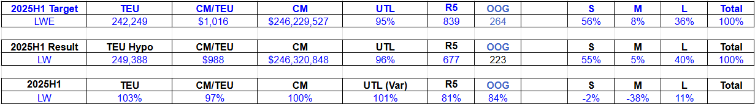
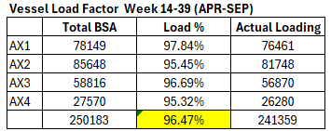
CGM / Vessel Utilisation / Cargo Portfolio
1) Continue to drive the volume (both CM/TEU)
2) Vessel load factor, 96%
3) S/M/L 55% / 5% / 40% (Target 56% / 8% / 36%)
4) Reefer/NOR (81%) - continue to drive NOR business, to the specific area. Control PE/MX.
5) OOG (84%) - non-SHA, direct call port (KR/JP/SPRC) with higher freight
6) Firecracker shipment - Review rate (USD10000/F) and follow up with sales (2 units/month)

Slide 3
Cargo mix optimisation / Yield Management
1) Route priority review – on going
2) Meet reefer demand - Partial achieved. Require continuous effort to induce NOR to Chile & Ecuador. Restricting PE/MX.
3) Tonnage/Move count control – Target achieved.
IQQ (average 159 moves) / AX2 (COBUN 16968tons) / AX3 (GTPRQ 9698tons) / AX3 (ECGYE 4189tons)
4) Equipment matchback – Below expectation
D2 – PECLL (9TEU/week)
D5 – COCLO (Cali) /CLCNL/CLLQN/CLSVE
R5 – PEPAI/ECGYE
5) Extra loader / blank sailings – Meet expectation. 9 blank sailings (1/1/6 AX2/AX3/AX4)
6) Monthly review of cargo mix and steering to maximize profit
Review L/M performance.
Remove RFA for inactive accounts
7) One Quote – Target 622TEU vs Actual 87TEU
8) Improve AP flexibility – initiate discussion with DYM (2nd half)
9) Digitalisation – Chorus (ongoing) / EagleX (ongoing) / OneForce (weekly/announcement/ campaign)

Slide 4
Action Plans (2H 2025)
1) TEU & CM – all pricers (NOR, OOG promotion and EQP matchback promotion)
NOR – Ron / Simon / SoonAng
OOG – Simon / SoonAng / Ron / BK
2) Vessel Utilisation (Main coordinator, Ron with the support Ko/Adele/BK/Kazuki/Delaloye).
Extra loader & blank sailings
3) Firecrackers (Soon Ang & Simon)
4) NOR / EQP matchback / WCCA (MAR/MX2/MX3) monitoring (Delaloye) + all pricers to drive the volume
5) Review of cargo mix and steering to maximize profit (Soon Ang – AP vs Actual analysis / all pricers)
Review L/M performance.
Remove RFA for inactive accounts
6) Improve AP flexibility – initiate discussion with DYM (Boon Keng / Kazuki / Simon)
7) Product catalogue – Kazuki
8) COD - Kazuki
9) Digitalisation
Chorus - Adele / Soon Ang
Snow – Ron / Ko
Tiger - Soon Ang / Adele
One Quote - Soon Ang / Kazuki
Bear – Ko / Ron
EagleX - Kazuki

Slide 5
Thank you

